Slide 1
ECE 6554: ADVANCED C.V TOPIC: UNDERSTANDING OF DEEP NEURAL NETWORKS
By,
Pranav Murthy,
Masters(CpE)

Slide 2
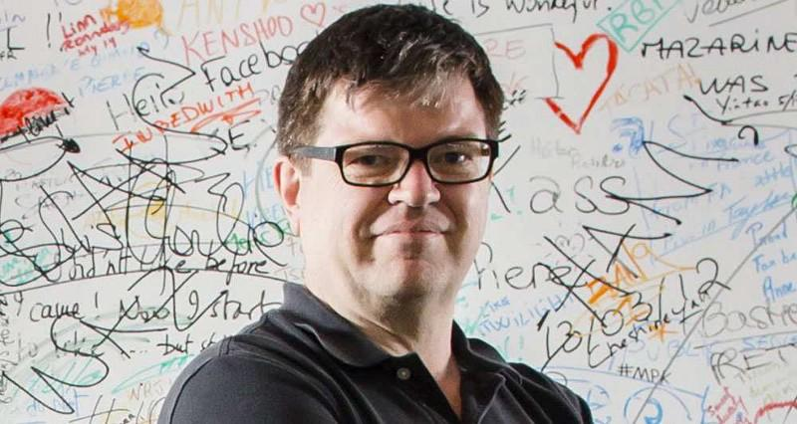
CONVOLUTIONAL NEURAL NETWORK
A convolutional neural network (CNN, or ConvNet) is a type of feed-forward artificial neural network.
Connectivity pattern between its neurons - inspired by the organization of the animal visual cortex
CNN was introduced by Yann LeCun (early 1990s).

Slide 3
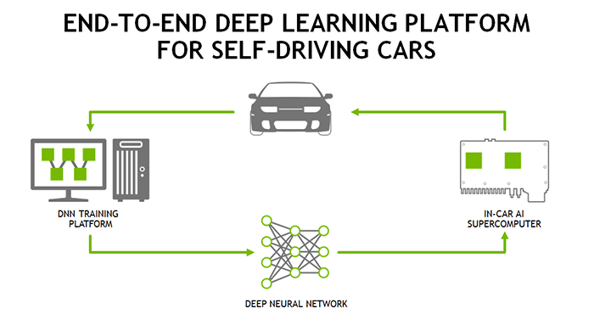
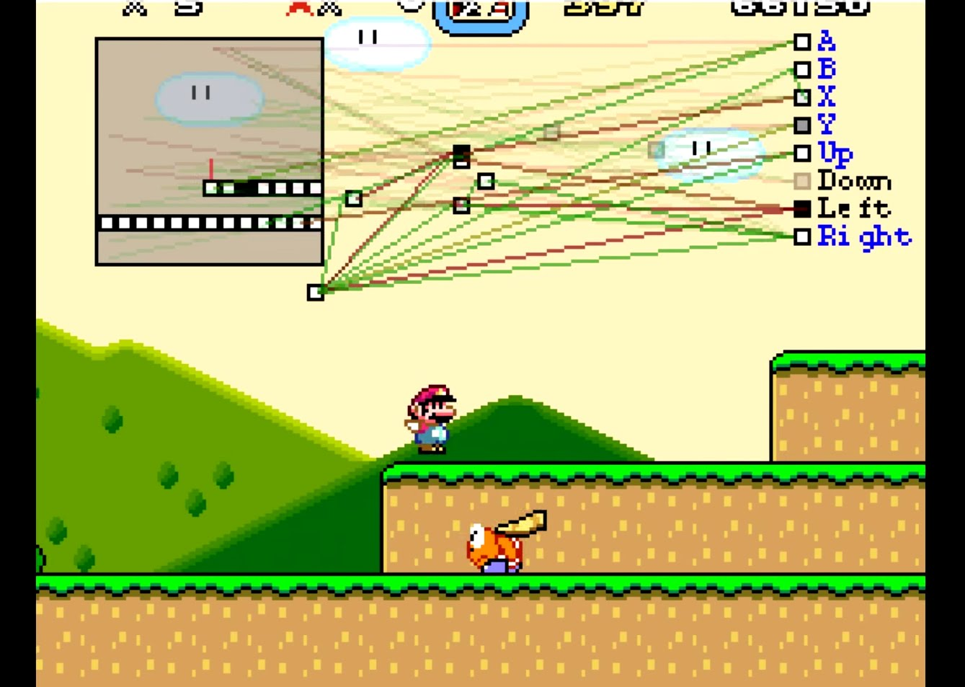
CONVOLUTIONAL NEURAL NETWORK
Deep Neural Network are networks comprised of many layers which aid in learning features off Images, Sounds, Texts, etc…
These Multi-layer networks learn low level, mid level and high level features off of these inputs look like.
They are surpassing humans in everyday challenging tasks. Ex: Self driving cars, playing video games, predicting stock prices, etc..

Slide 4
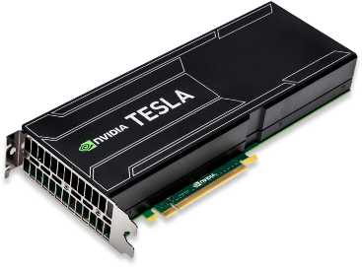
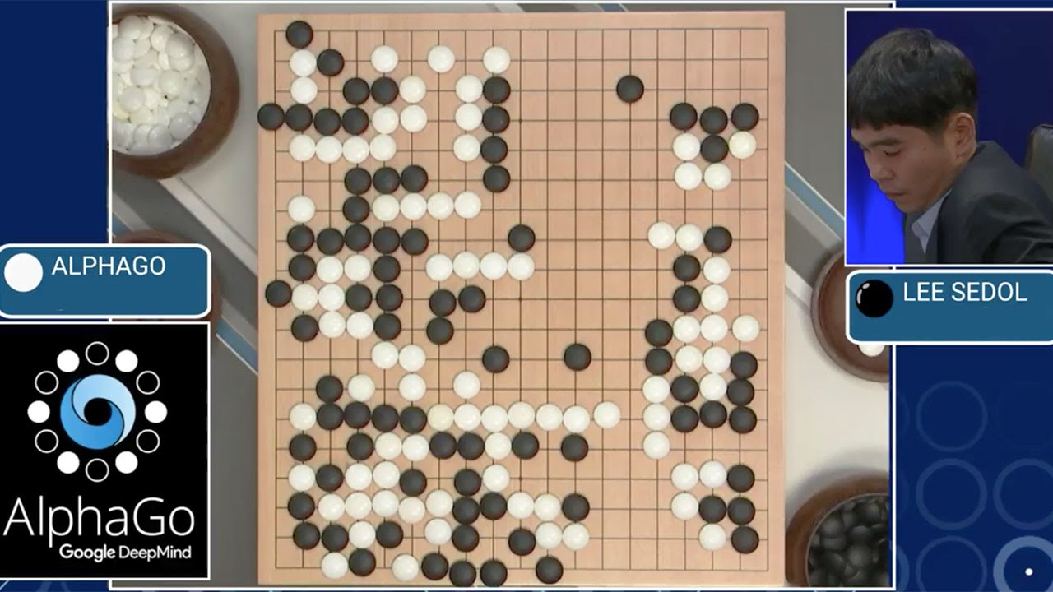
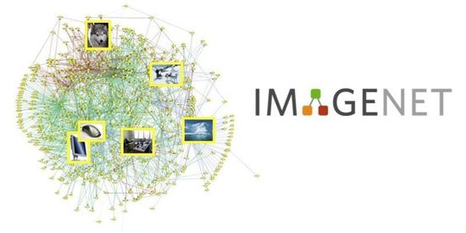
WHY are CNNs so POPULAR??!
They are able to achieve human like performance in a large number of tasks and even surpassed humans in a few.
example: AlphaGo challenge, ILSVRC challenges, etc..
Reason for their advancements ?
Larger training sets - millions of labeled examples
Powerful GPUs - training of very large models practical
Better model regularization strategies - ex: Dropout, L2 regularization, ReLu, etc.

Slide 5
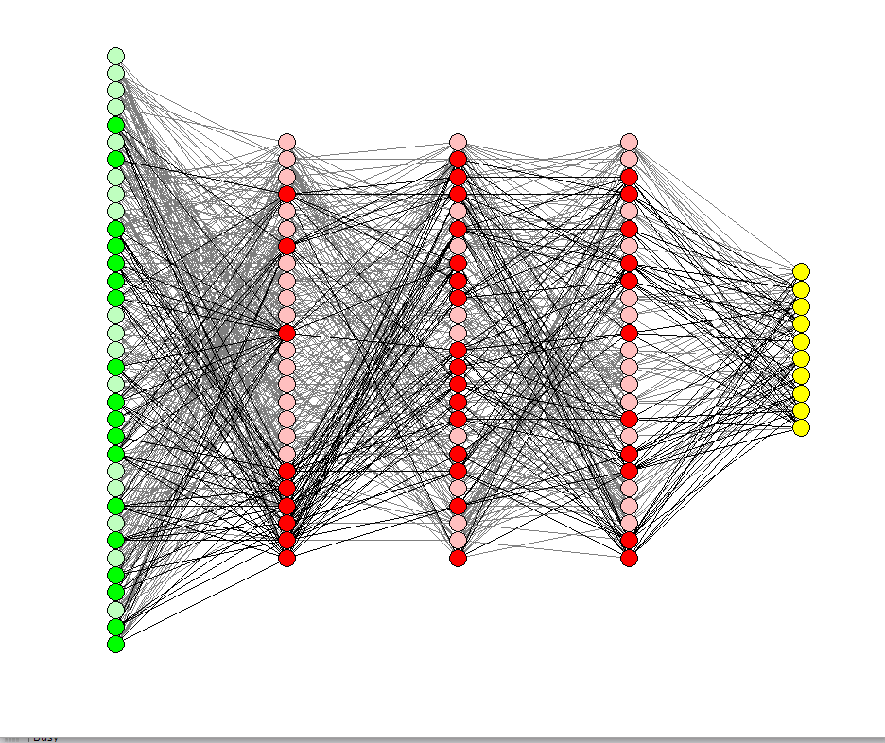
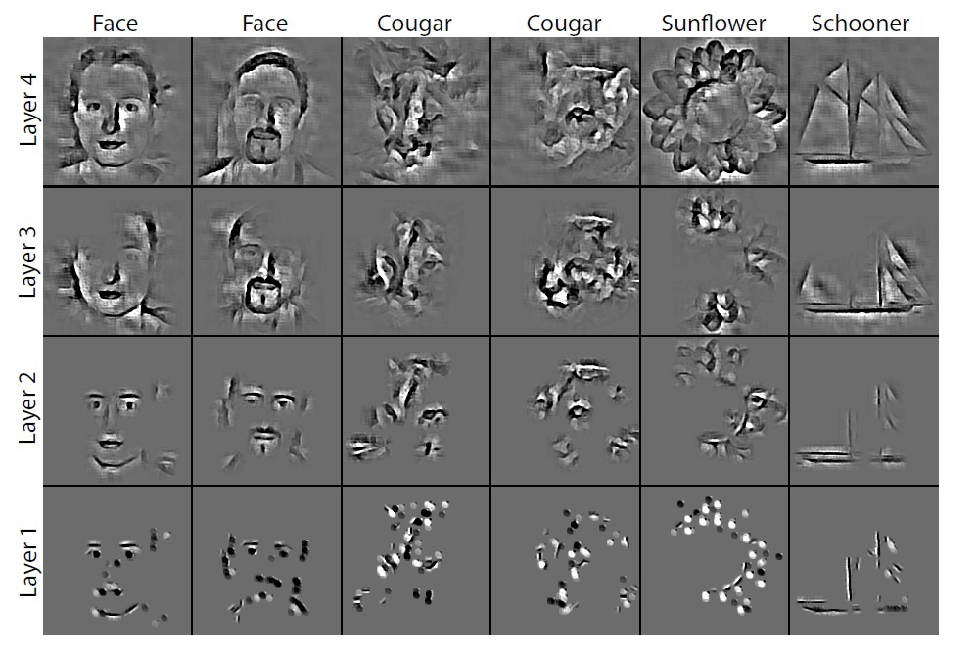
They work very well….but why?
CNNs have been long considered as blackboxes.
People know they work very well, but only a few know why,
Due to the large number of interacting parts (ex: 60 million working parameters, 10(s) to 100(s) of hidden layers, 1000s of neurons each holding an unknown matrix value, etc..)
Interconnected nonlinear parts
Understanding how they work is critical to designing better and deeper networks:
Deconvolutional technique for visualizing the features learned by the hidden units of CNNs
Suggesting architectural changes to convolutional filters to better improve performance of CNNs.

Slide 6
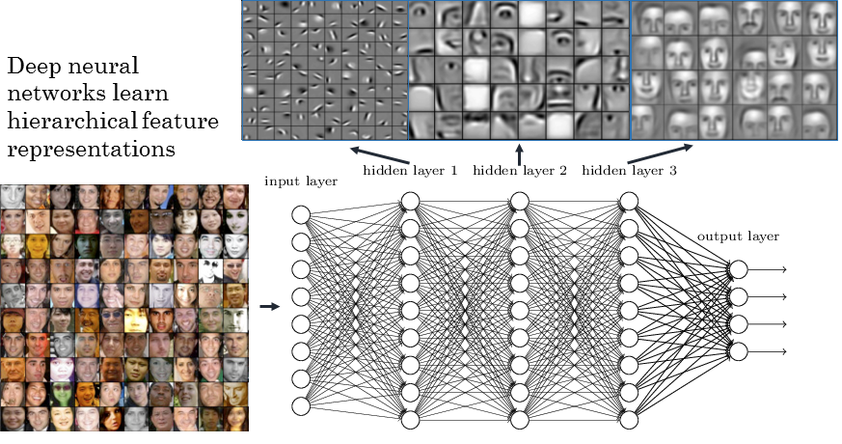
WHAT ARE THEY LEARNING??

Slide 7
UNDERSTANDING A DNN
There are 2 methods to understanding what computations are performed at each layer in DNNs
Approach 1: Study each layer as a group and investigate the type of computation performed by the set of neurons on a layer as a whole (neurons work together and pass information to next layers together, hence informative).
Approach 2: Interpret the function computed by each individual neuron.
Dataset-centric: requires a trained network and data running through the network.
Network-centric: requires only a trained network.

Slide 8
BENEFITS of VISUALIZING DNNs
Helps with development of newer and better techniques for training and testing.
Helps newcomers understand why a model they build works or does not work.
Help experts build on ideas for new models or vary hyper-parameters to obtain a state-of-the-art model.
Paper: Understanding Neural Networks Through Deep Visualization provides two such tools to help users that build DNNs to understand them better,
Interactively plots the activations produced on each layer of a trained DNN for user provided images or video
Enables visualization of the learned features computed by individual neurons at every layer of a DNN.
Seeing what features have been learned is important both to understand how current DNNs work and to fuel intuitions for how to improve them.

Slide 9
PAPER’s CONTRIBUTION:
There are essentially 2 contributions from this paper with respect to visualization of DNNs,
(VISUALIZATION)Describe and Release a Software Tool that provides a live, interactive visualization of every neuron in a trained convnet as it responds to a user-provided image or video. This tool displays - forward activation values, preferred stimuli via gradient ascent, top images from each training set, deconv highlights of top images and backward diffs computed via backprop or deconv starting from arbitrary unit.
(BETTER THE VISUALIZATION) Extended past efforts to Visualize preferred activation patterns in input space by adding several new types of regularization, which produce interpretable images for large convnets.
Link: http://yosinski.com/deepvis

Slide 10
PART 1: VISUALIZATION LIVE CONVNET ACTIVATIONS
Plot activation values for the neurons in each layer of a convnet in response to an image or video.
FC units plots are spatially uninformative and order of the units is irrelevant.
Filters are applied in a way that respects the underlying geometry.
For example: for a 2D image, filter are applied in a 2D convolution over 2 spatial dimensions. Convolution produces activations on subsequent layers for each channel that is spatially arranged.

Slide 11
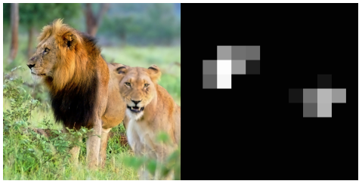
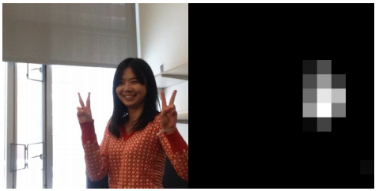
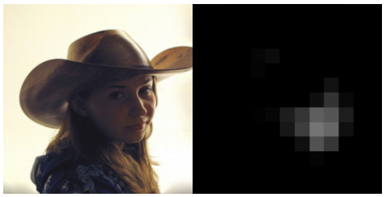
DEMO SOFTWARE INTERFACE
Displays the output of all of the layers within the ConvNet
The layers are displayed as a grid of smaller images and selecting that image within the grid zooms on that particular image.
For example: Conv5 layer had 256x13x13 where 256 are the number of images tiled as 16x16 with images that are grayscaled 13 x 13 images.
Below are zoomed in view of one particular channel of conv5 (151) that responds to human and animal faces,

Slide 12
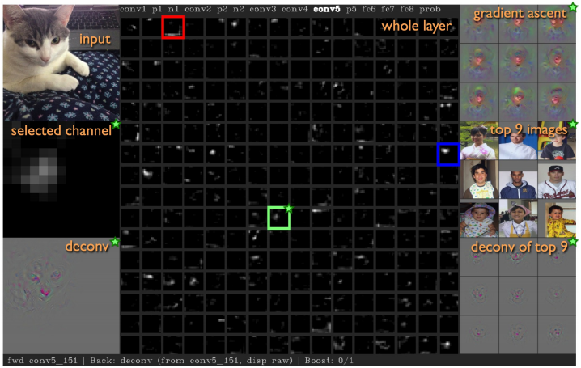

Slide 13
OBSERVATIONS
Representations on some images are surprisingly local; for instance in the paper, conv4 and con5 consisted detectors for text, flower, faces and fruits. Observed through live visualizations or optimized images.
Classifying clear images from Flickr, Google Images, etc the classification was really confident and right most of the time.
Results through webcam on the other hand was poorer.
None of the images from the trained classes were shown to the net. Hence no single high probability (as expected)
Incorrect prediction vectors varied aot with noisy input from webcam. Sensitive to small changes in input. Plotting fc revealed the sensitivity to small input changes.
The lower layers computations are more robust. For instance: when analyzing the conv5 it contains detectors for shoulders, face, text when subjects moved in front of the camera though nothing in the dataset explicitly stated these features.

Slide 14
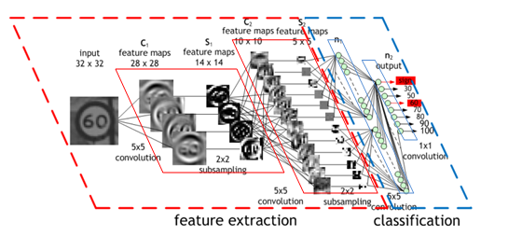
ADVANTAGES OF THE SOFTWARE TOOL
Informative and easy to implement.
Helps visualize the data flowing through the network
Layers are small enough that one layer can fit into a computer screen.
Importantly CNNs are no more a blackbox ! Which enables users to understand what going on inside their design and how to improve it further.

Slide 15
CODE DEMO

Slide 16
SYSTEM SET-UP
Ubuntu / Windows
GPU (optional) with CUDA (Optional)
Caffe (latest version preferred)
Deep Visualization Toolbox
Scipy, Numpy, OpenCV and Skimage
Python 2.7 or 3.5 (works with anaconda)

Slide 17
CNN TOPOLOGY
Conv 1
Poo l 1
Conv 2
Poo l 2
Conv 3
Conv 4
Conv 5
Poo l 3
Fc 1
Fc 2
Fc 3
Softmax
[P]

Slide 18
PART 2: VISUALIZATION VIA REGULAR OPTIMIZATION
Second contribution of this work is introducing several regularization methods to bias images found via optimization toward more visually interpretable examples.
Each of the regularization method is useful by itself but together (found via random hyperparam search) they prove to be more useful than when used individually.
These methods are designed to overcome certain problems that are encountered in Gradient Descent without regularization.
Methods are as below:
L2 Decay
Gaussian Blur
Clipping pixels with small norm:
Clipping pixels with small contributions

Slide 19
L2 DECAY
Example Image flowing through the ConvNet consists of large amplitudes.
L2 decay common regularization decay technique that penalizes large values (large amplitude values).
Implemented as
r_{θ}(x) = (1−θ_{decay})·x
L2 decay tries to prevent a small number of extreme pixel values from dominating the example image.
Intuition: Such extreme single-pixel values neither occur naturally with great frequency nor are useful for visualization

Slide 20
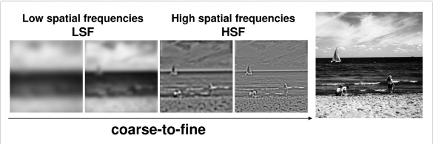
GAUSSIAN BLUR
Producing images via gradient ascent tends to produce examples with high frequency information.
Sometimes images are unrealistic and non-interpretable.
Useful regularization is thus to penalize high frequency information using a gaussian blur step,
r_{θ}(x) = GaussianBlur(x, θ_{b_width})
Do this every few steps and using smaller kernels instead of every step and larger gaussian kernels to remove computation overhead.

Slide 21
CLIPPING PIXELS WITH SMALL NORM
L2 Decay and Gaussian Blur suppress high amplitude and high frequency information.
The image contains small, somewhat smooth values which may tend to contain non-zero pixel values.
These stray pixels will also shift to show some pattern and contributing to ultimately raise the chosen unit’s activation.
We wish to search away from such a behaviour and only show the primary object under activation.
The bias is implemented using an rθ(x) that computes the norm of each pixel over RGB channels and then sets any pixels with small norm to zero.
The threshold for the norm,is specified as a percentile of all pixel norms in x.

Slide 22
CLIPPING PIXELS WITH SMALL CONTRIBUTIONS
Instead of clipping pixels with small norm we can clip pixels with small contributions.
Pixel contribution is directly proportional to amount of activation it increases or decreases when set to 0.
This method is slow and requires forward pass for every pixel.
To make it faster it is approximated by linearizing ai(x) around x, in which case the contribution of each dimension of x can be estimated as the elementwise product of x and the gradient.
Then sum over all three channels and take the absolute value, to find pixels with small contribution in either direction, positive or negative.
This rθ(x) is the operation that sets pixels with contribution under the θc pct percentile to zero.

Slide 23
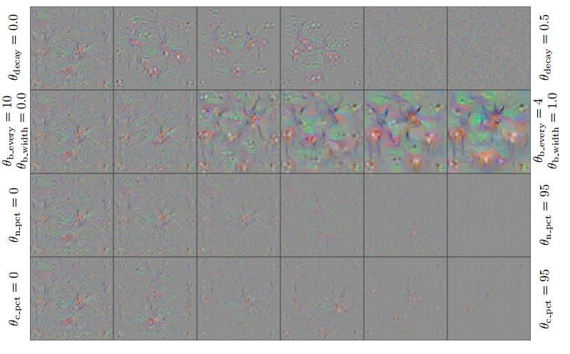
Each HypParam applied individually

Slide 24
COMBINATION OF HYPERPARAMETERS
Preliminary experiments uncovered that their combined effect of parameters produces better visualizations.
To pick a reasonable set of hyperparam a random hyperparam search of 300 combinations are settled on 4.
A combination of these values were run on images ,
Some images showed high frequency values
Some images show low frequency values
Some contain dense pixel data
Some contain sparse outlines of important regions

Slide 25
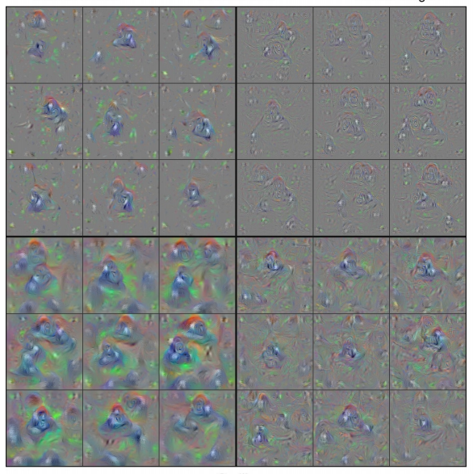
Sparse Set of Imp regions
High Frequency Patterns
Dense Pixel Data
Low Frequency Patterns

Slide 26
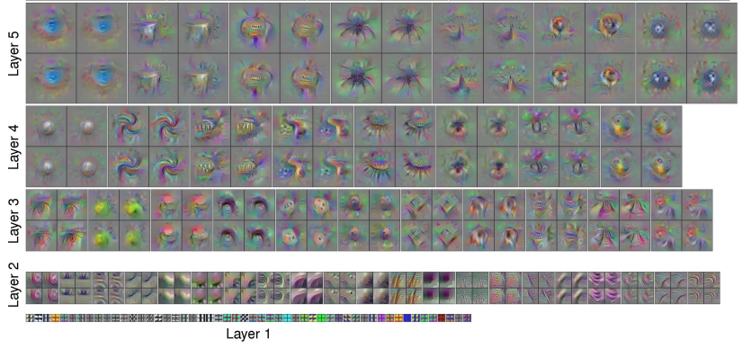
Visualization of Example Features of Eight Layers of CNN

Slide 27
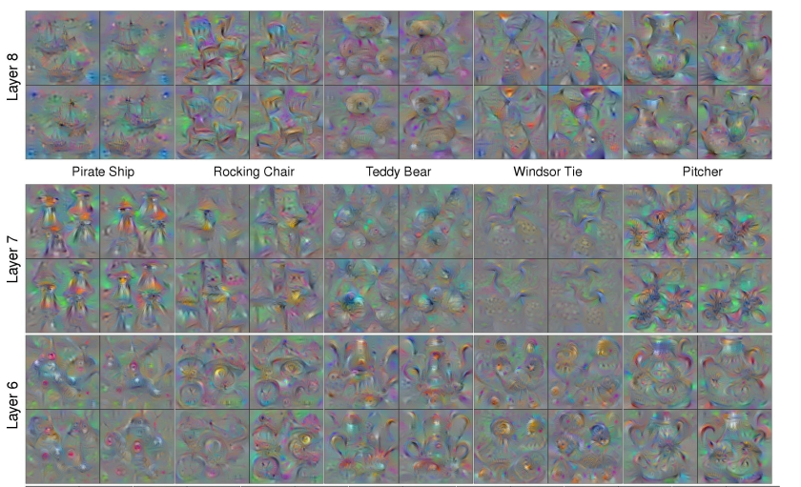
Visualization of Example Features of Eight Layers of CNN

Slide 28
FUTURE WORK
Later conv layers tend to be more local (features of faces, wheel, etc..) instead of dimensions in a distributed code. But not all features correspond to natural parts. Thus opening up research to find the exact nature of learned representations. This could also be helpful in transfer learning when new models are trained atop the mid conv layer representations, a bias toward sparse connectivity could be helpful because it may be necessary to combine only a few features from these layers to create important features at higher layers.
New regularization methods that enables improved, interpretable, optimized visualizations of learned features. This will help researchers and practitioners understand, debug, and improve their models.
Preventing model-fooling by understanding the workings of hidden layers of the ConvNet.

Slide 29
CONCLUSION (TOPIC)
We have a new visualization tool that helps us understand the workings of a convnet in detail by exploring the hidden layers.
Helps in debugging models and coming up new and improved training and testing strategies.
Helps with contribution of new methodologies and techniques in the field of DNNs (new regularization techniques, incorporate unique training strategies, etc..)
Disadvantage, concepts arent easy to grasp without a practical knowledge on the topic.

Slide 30
CONCLUSION (SOFTWARE)
Interface is very simple and easy to navigate.
Has a camera add (did not work for me!), a nifty feature.
Useful for researchers and newcomers alike.
Takes time to understand the flow of the layers

